Slide 1
Do fish traits predict their response to drought?
selected species from the Fall Midwater Trawl in the Sacramento-San Joaquin Estuary

Slide 2
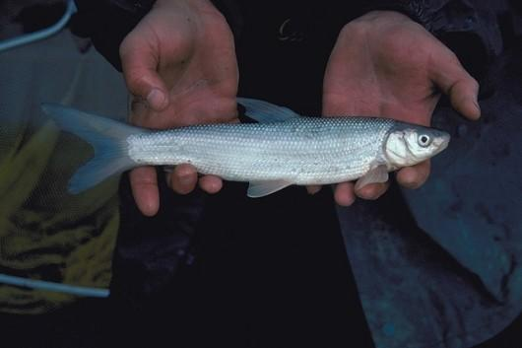
“Important” fish species of the estuary
American Shad
Pacific Herring
Threadfin Shad
Northern Anchovy
Delta Smelt
Striped Bass
Chinook Salmon
Splittail
Longfin Smelt
Yellowfin Goby
White Sturgeon
White Catfish
Topsmelt
Jacksmelt
Shiner Perch
White Croaker
Channel Catfish
Starry Flounder
Plainfin Midshipman

Slide 3
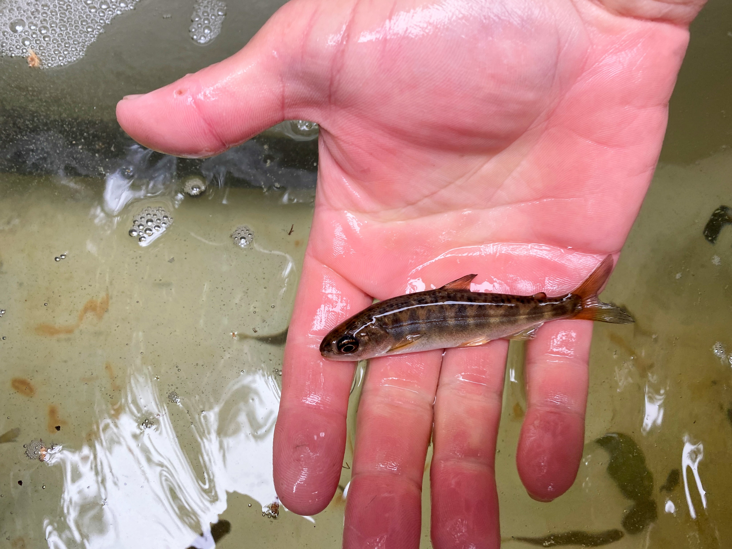
Species selection based on
primarily on numerical abundance in the FMWT trawl indices
secondarily on ecological, sociological and/or management relevance
definitely somewhat squishy…but defensible!

Slide 4
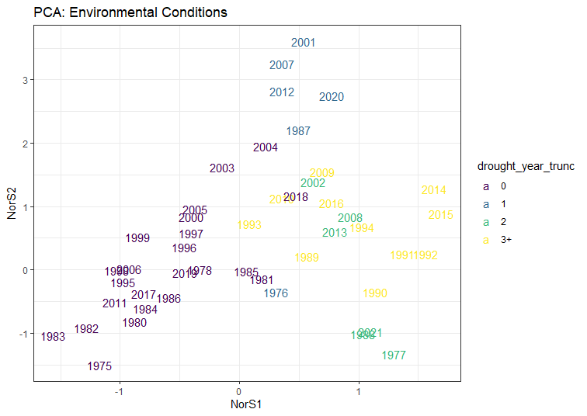
Notes:
manova on years classified by drought length? could use original fenv data or eigenvalues from PCA

Slide 5
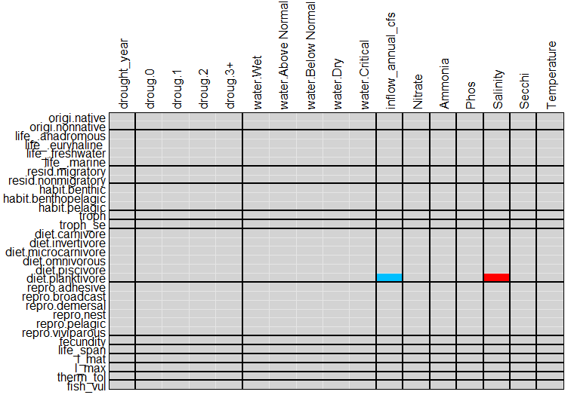

Slide 6
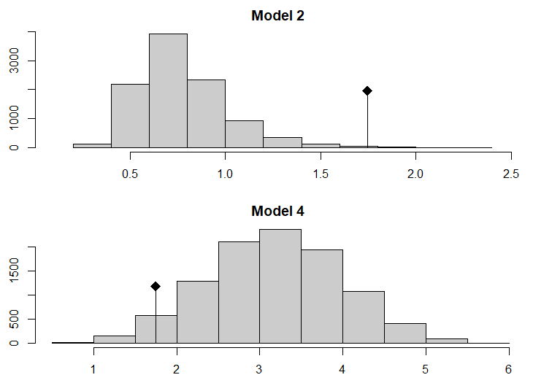

Slide 7
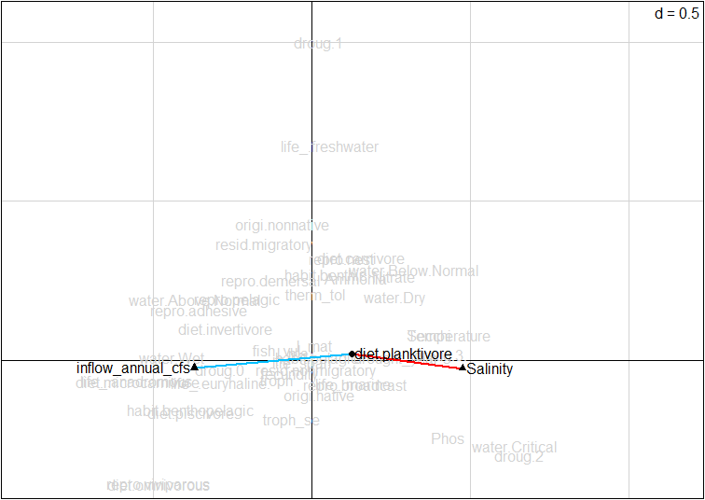
Planktivores affected by salinity(+) & flow(-)
RLQ scores: traits & environment Biplot: significant associations
blue: negative
red: positive

Slide 8
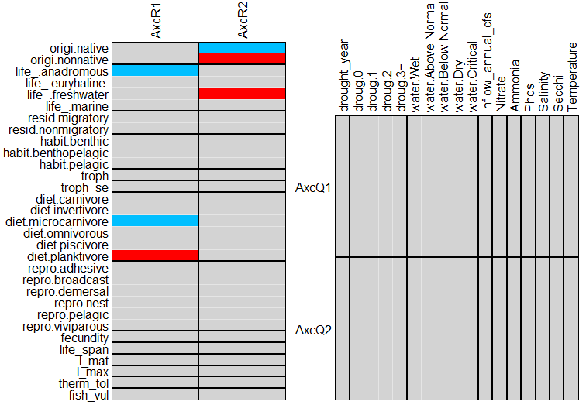

Slide 9
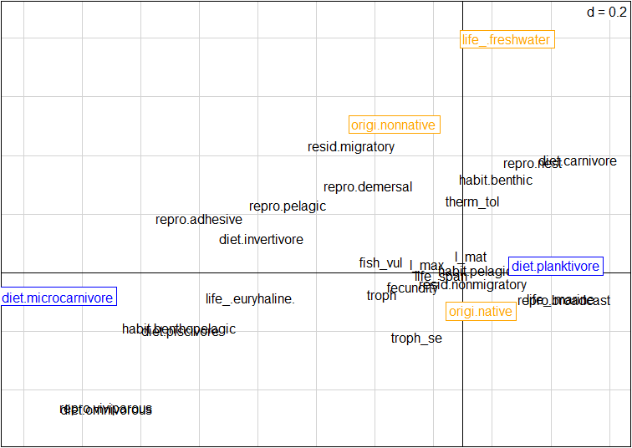

Slide 10
Total inertia of RLQ analysis
Monte-Carlo test
Std. Obs. | Expectation | Variance
-1.7950 | 3.1759 | 0.6346
 | observation = 1.7460 | simulated p-value = 0.9631
Links between RLQ axes & traits
fourthcorner.rlq function
test | alt hypothesis | p-value
AxcR1 v habitat.benthic | less | 0.02640
AxcR2 v habitat.benthic | less | 0.02670
AxcR1 v diet.invertivore | less | 0.0540
AxcR2 v diet.invertivore | less | 0.0829
AxcR1 v therm_tol | 2-sided | 0.9595
AxcR2 v therm_tol | 2-sided | 0.0274

